Slide 1

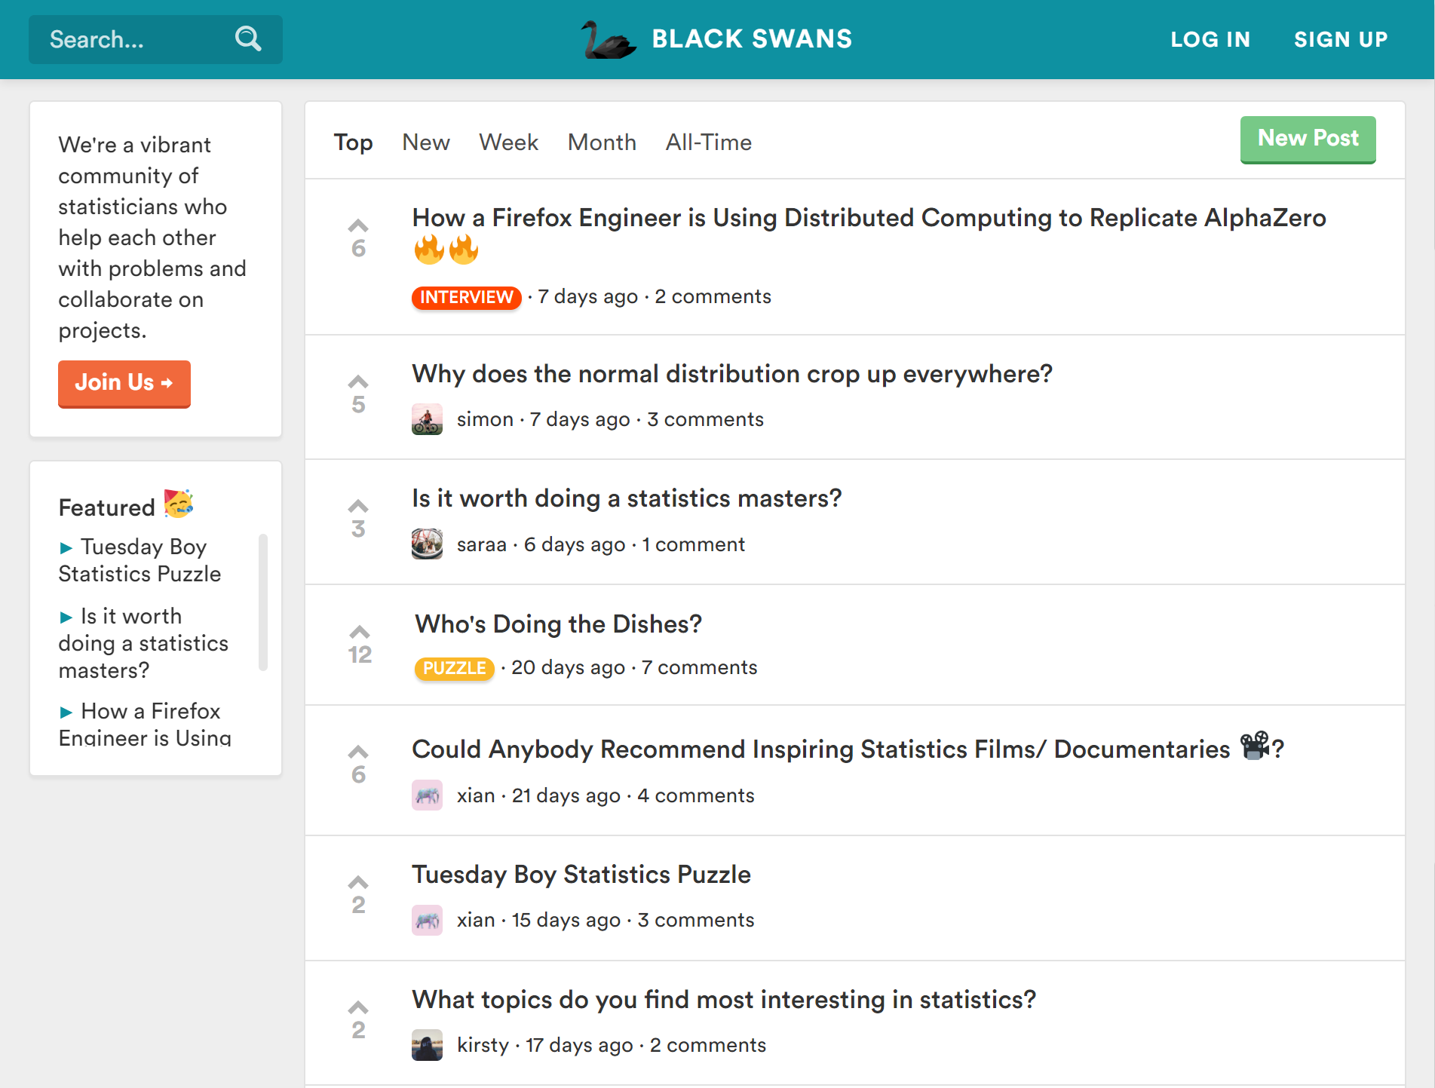
BLACK SWANS
We’re a tight-knit group of students and lecturers who help each other with statistics problems and collaborate on projects.
Sign up at www.blackswans.io to join the community!

